Slide 1
ART GALLERY
Vishakh, Maya, and Rudra

Slide 2

ROOM
A
“Shrek Gogh”

Slide 3
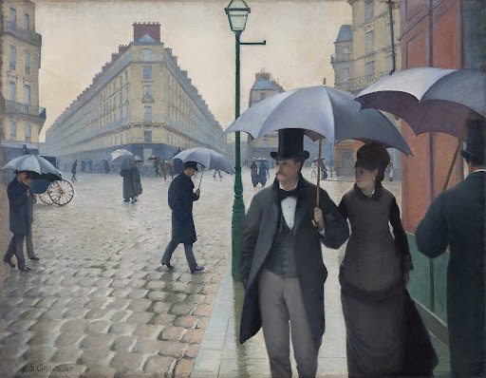
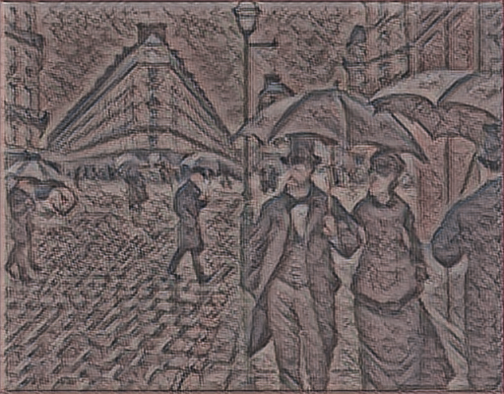
ROOM
B
“Style Swapped by Tinted Glass”

Slide 4
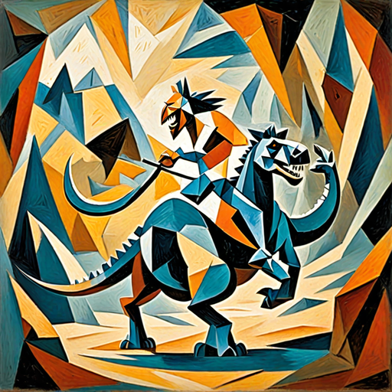
ROOM
C
“If Cavemen Lived 66 Million Years Ago”

Slide 5
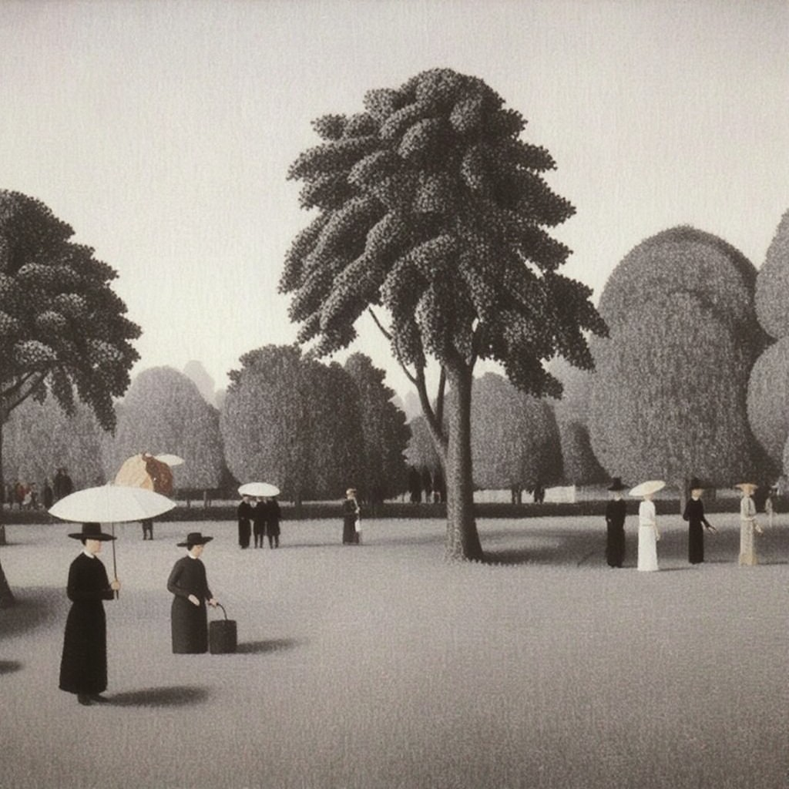
ROOM
D
“Grey”

Slide 6
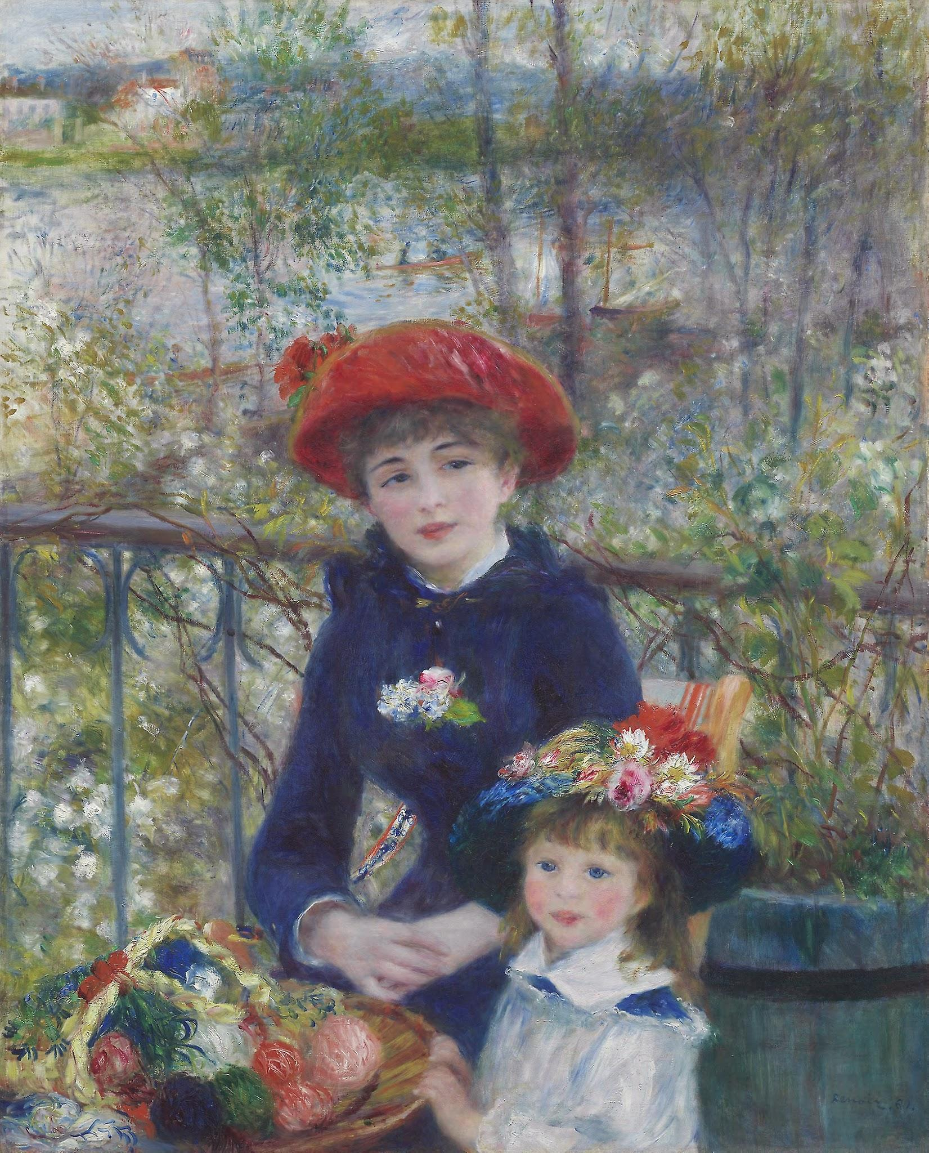
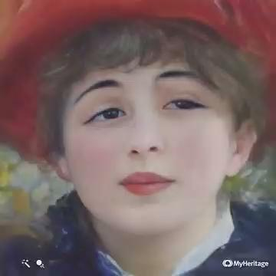
ROOM
E
Image to Video

Slide 7
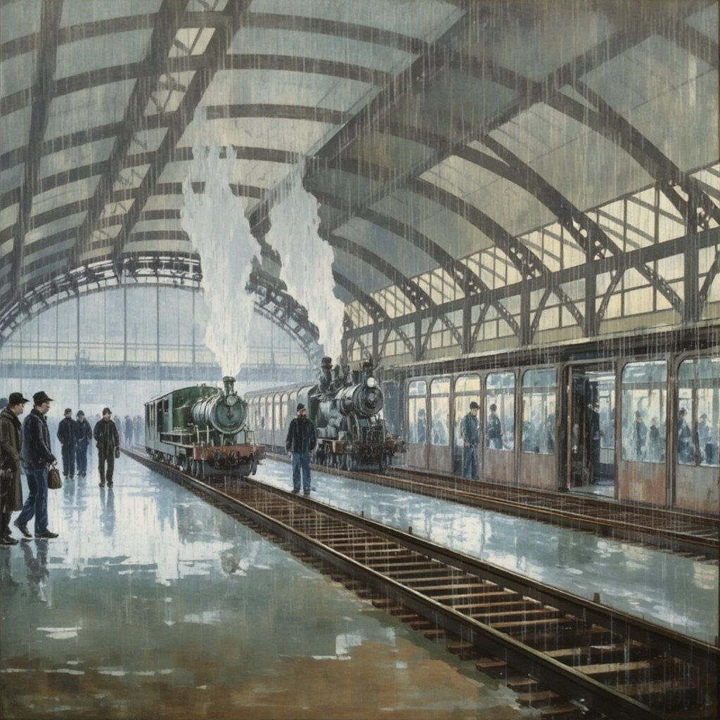
ROOM
F
Rainy Monday

Slide 8
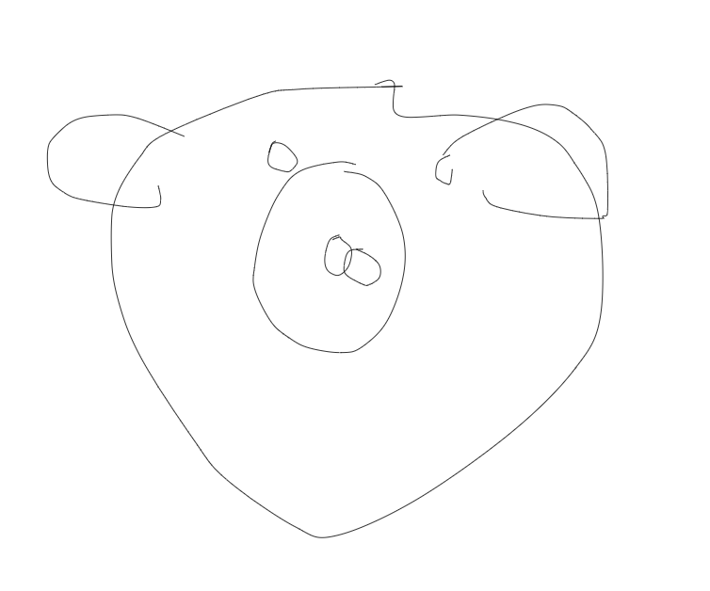
ROOM
G
RNN’s perspective of an “Elephant Pig”

Slide 9
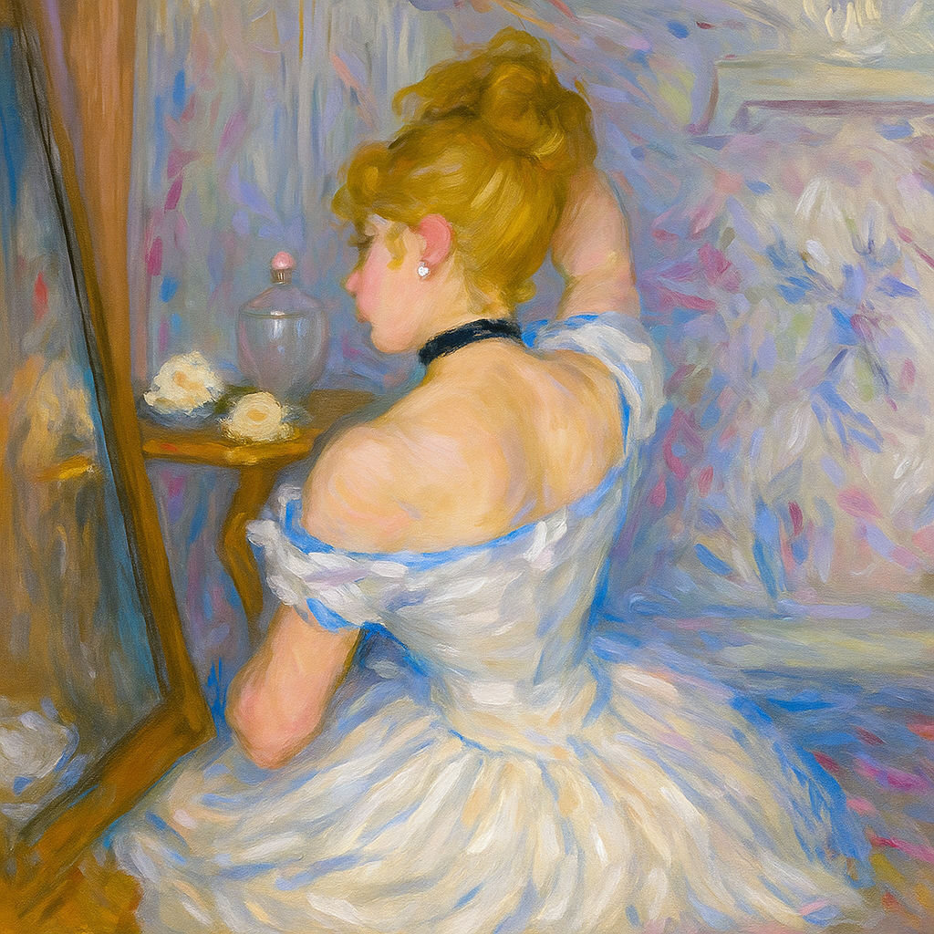
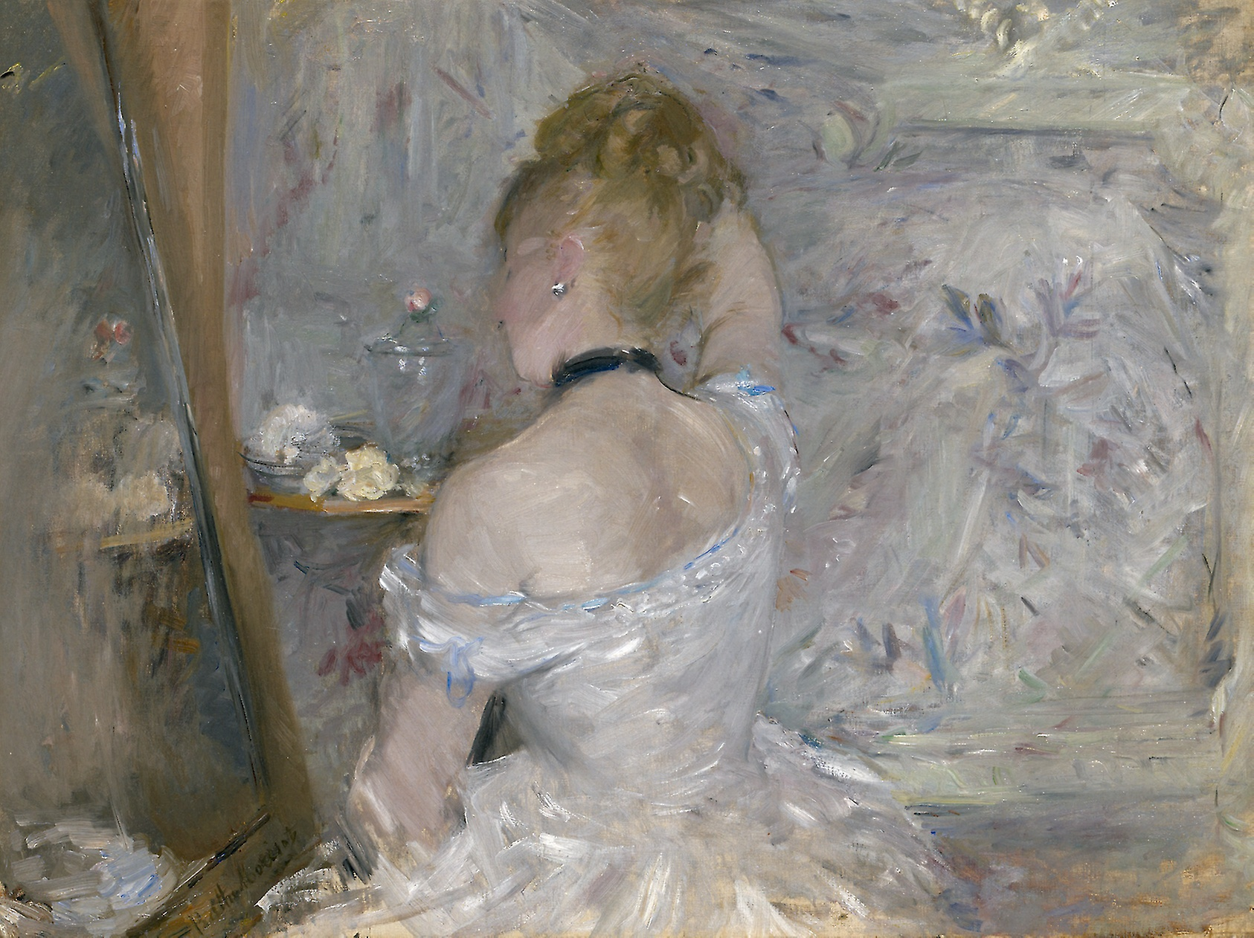
ROOM
I
*From old image
New Color and Animation*

Slide 10
ART GALLERY
Ritvik, Danica, Alaina

Slide 11

ROOM
A
Danica Ding

Slide 12

ROOM
B
Danica Ding

Slide 13

ROOM
C

Slide 14

ROOM
D
Danica Ding

Slide 15

ROOM
E

Slide 16

ROOM
F
Alaina Sharma

Slide 17

ROOM
G

Slide 18

ROOM
I
Alaina Sharma

Slide 19

Danica Ding

Slide 20
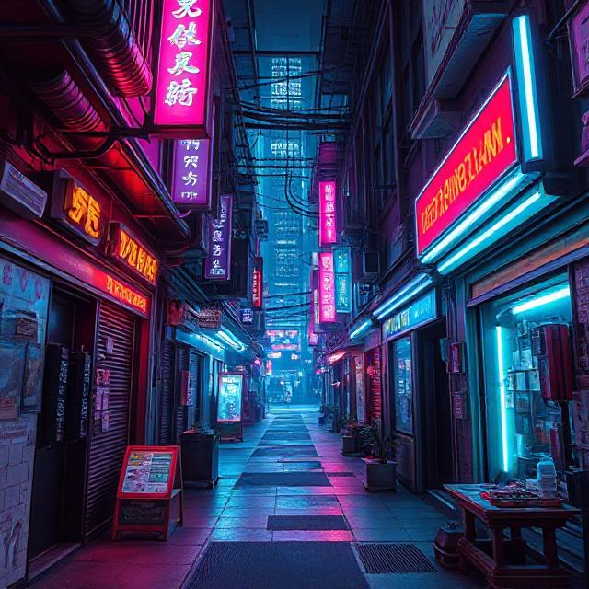

Slide 21

Jungle Kick-off

Slide 22

Polka Dot Pedals

Slide 23

Whimsical Hillside Home

Slide 24

Happy Wheels

Slide 25

Room K
Alaina Sharma

Slide 26
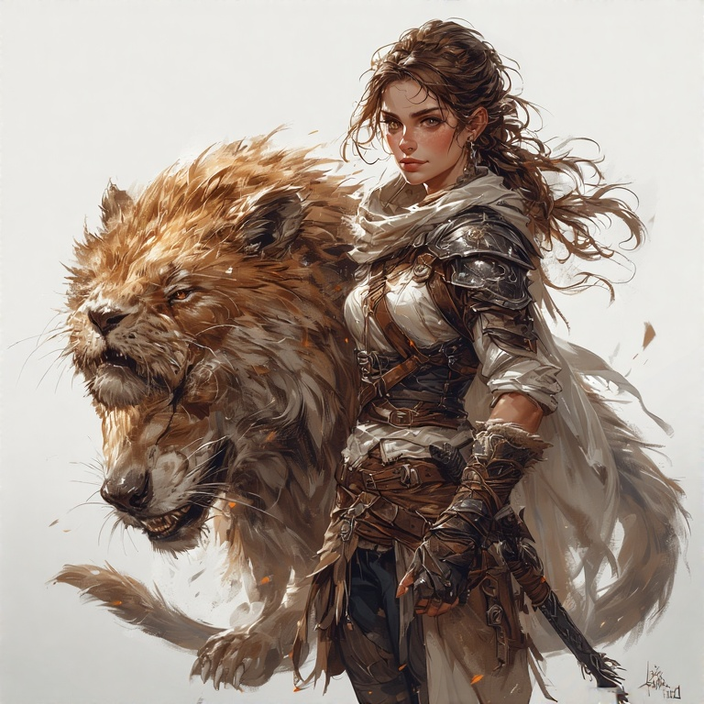
Room
L
Alaina Sharma

Slide 27

Room
M
Alaina Sharma

Slide 28

Room
M
Alaina Sharma

Slide 29

Room
M
Alaina Sharma

Slide 30

Room
M
Alaina Sharma

